Slide 1
PORTABLE GPS-BASED BICYCLE SPEEDOMETER / ODOMETER
M.A.E. WIJESURIYA
D/ENG/22/0120
STREAM : ET
Final Presentation of Individual Design Project 2024

Slide 2
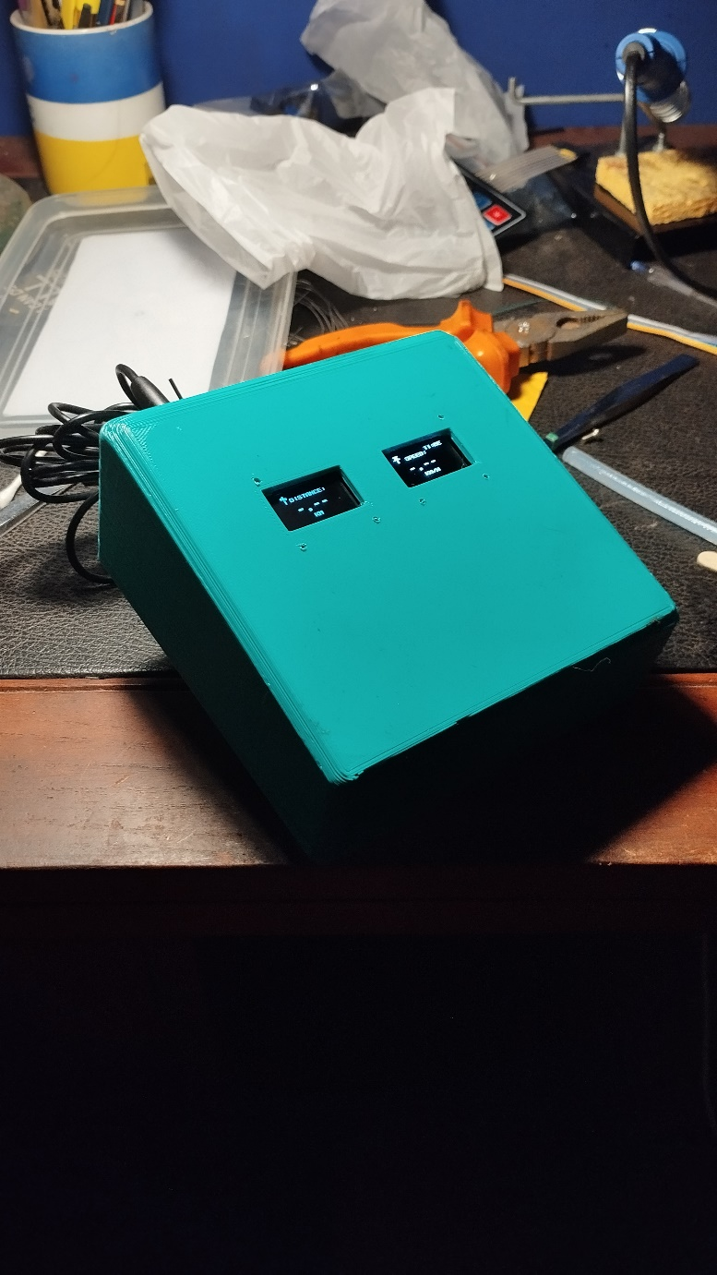
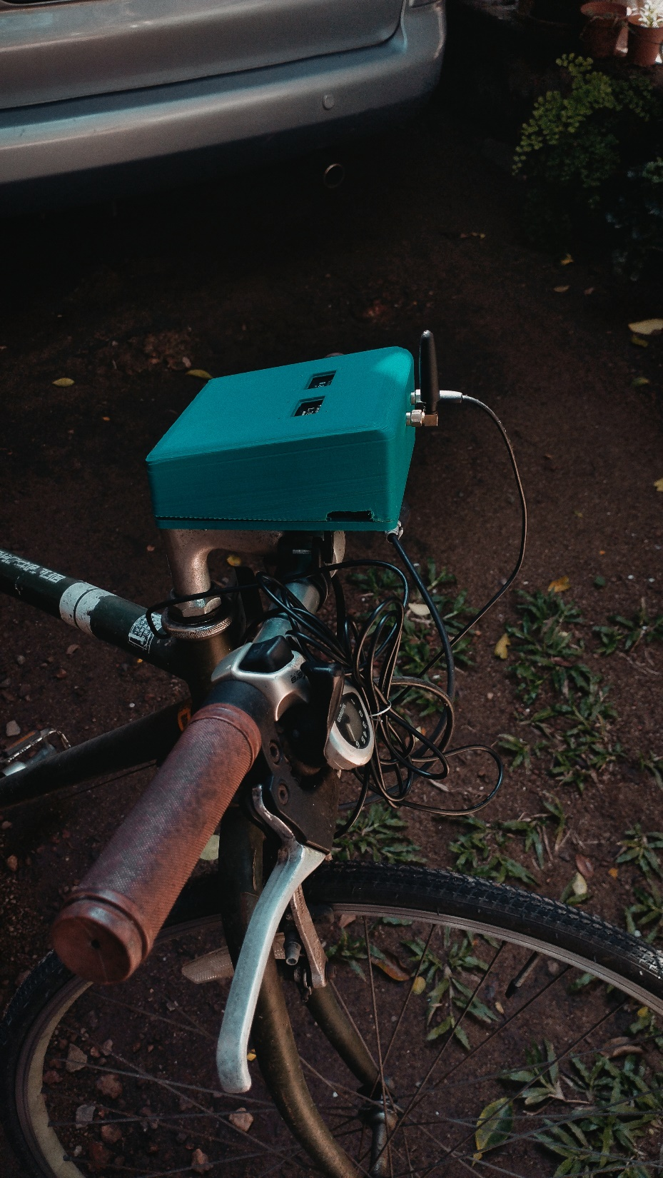
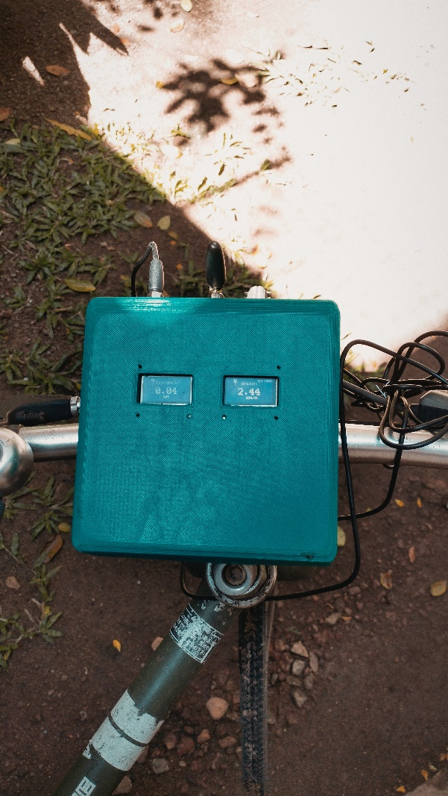
Product Outcome

Slide 3
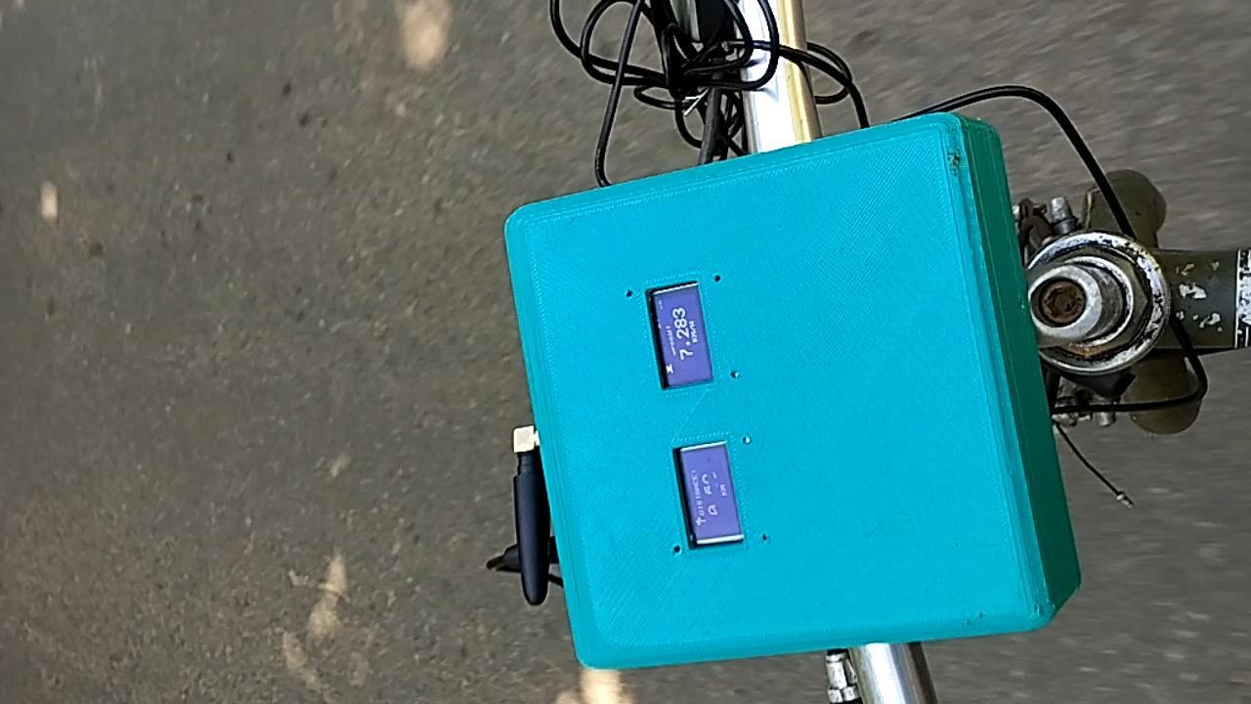
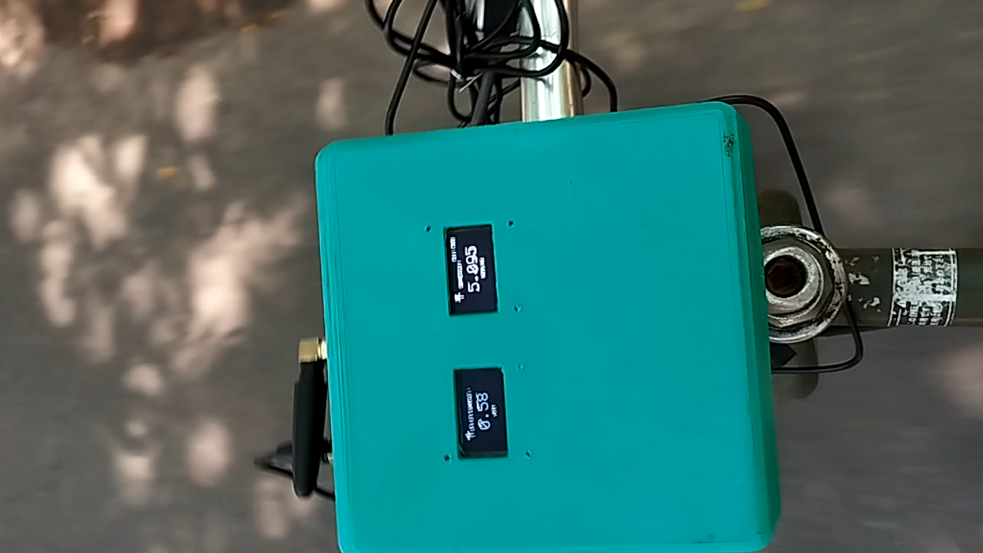
Product Outcome

Slide 4
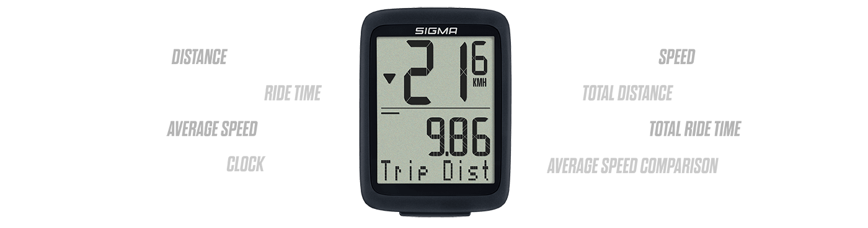
Selected Product
Bicycle Speedometer/ Cyclocomputer
As an aid when cycling for leisure and transportation
The Sigma BC 8.0 WL Cyclocomputer[1]

Slide 5
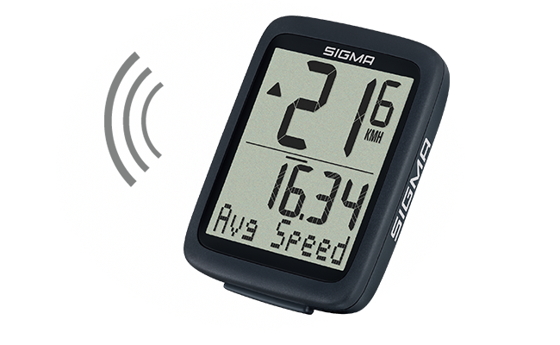
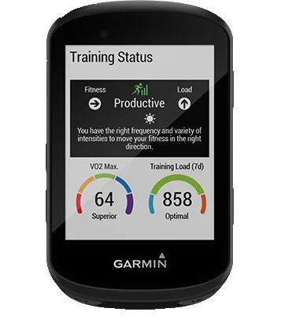
Product Survey Results
Primarily 2 types of Cyclocomputers:
[2]
“Budget” Hall-Effect sensor cyclocomputers
Inexpensive
Utilize Hall-Effect sensors for measurement
“High-End” GPS based Cyclocomputers
Expensive
Use GPS data for measurement
Targeted at professional cyclists

Slide 6


Objectives and Aims
Objective – To design, develop, and implement a GPS-based cyclocomputer utilizing low-cost components, offering real-time speed and distance tracking to the user, as well as server-based route mapping.
Aim - To empower cyclists with a low-cost device that provides real-time performance data and route visualization for better training and exploration, encouraging eco-friendly, healthier transportation.

Slide 7
Assumptions
Cyclists are in need of a method by which to track their cycling data and visualize their routes
The average cyclist would prefer to not risk damage to his smartphone by mounting it to their bicycle and utilizing it for cyclocomputer monitoring
The components used to build this are readily available, inexpensive, and accessible to the everyday user

Slide 8

System Design – (Hardware)
The final list of components included
Arduino Uno Rev3 Microcontroller board
NEO 6M GPS module with antenna
SIM800L GSM/GPRS module with antenna
18650 Battery Supply Module V8 5V/3A
2 x SSD1306 0.96” 128x64 OLED Displays
DC to DC Adjustable Step-Up Power Supply Module
4-Channel 3.3V 5V Bi-Directional Logic Level Shifter Module
3D printed casing (PLA) with bicycle mounts

Slide 9
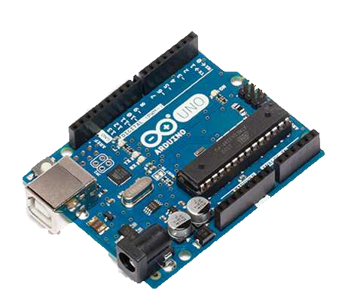
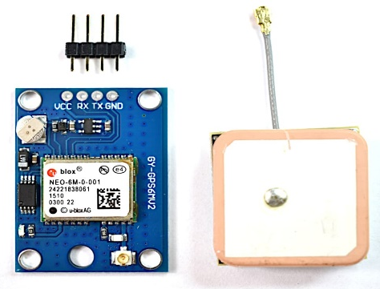
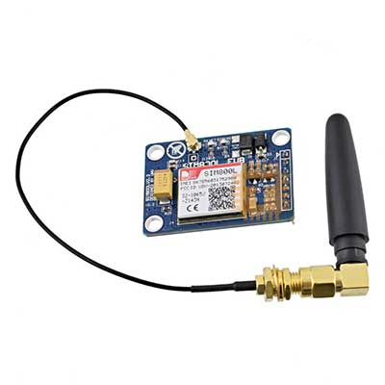
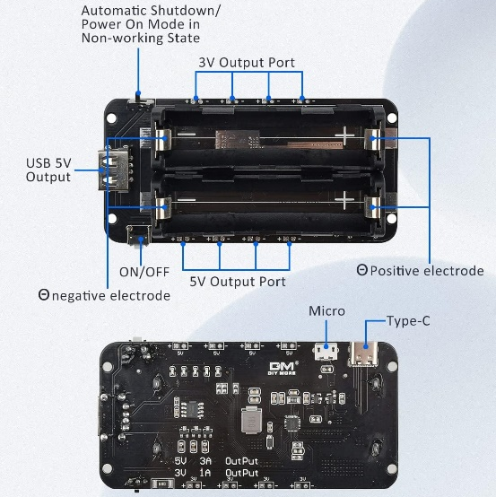
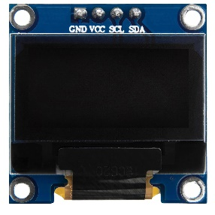
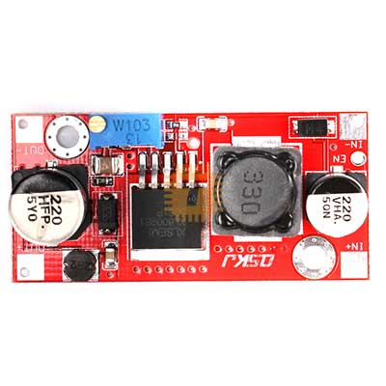
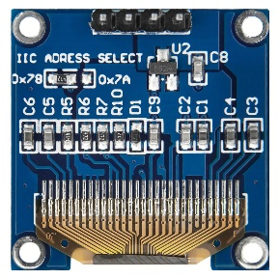
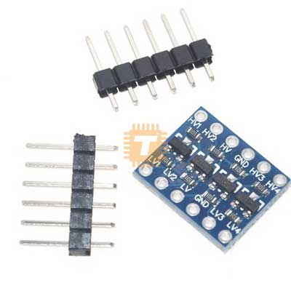
System Design – (Hardware)
Arduino Uno Rev3 [3]
NEO 6M GPS Module w/ antenna [4]
SIM800L GSM/GPRS Module w/ antenna [5]
DC to DC Adjustable Step-Up Power Supply Module
[8]
4- channel 3.3V 5V Bi-Directional Logic Level Shifter [9]
18650 battery holder V8 [6]
SSD1306 OLED Display [7]

Slide 10
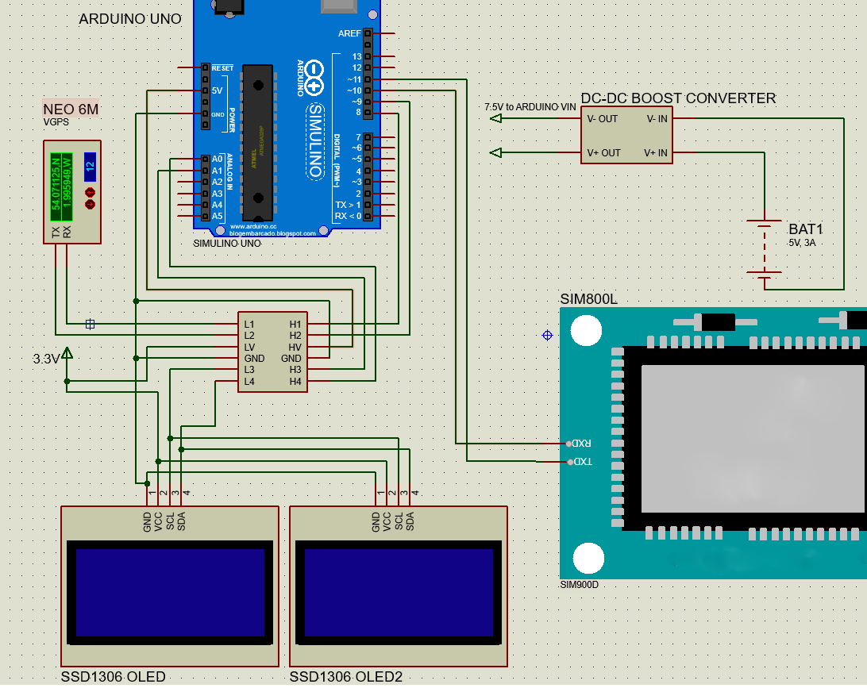
System Design – (Hardware)

Slide 11
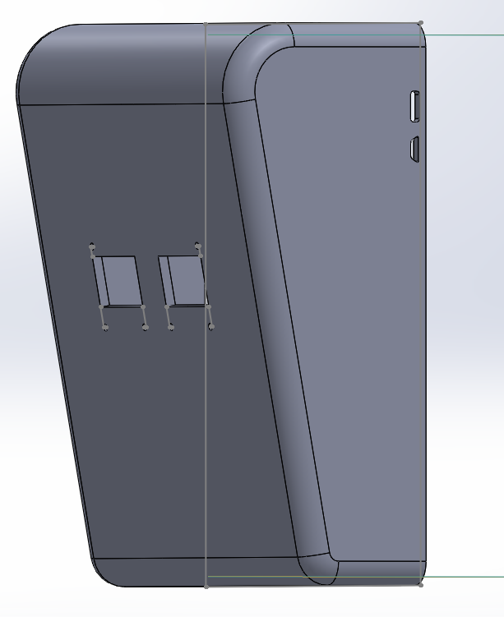
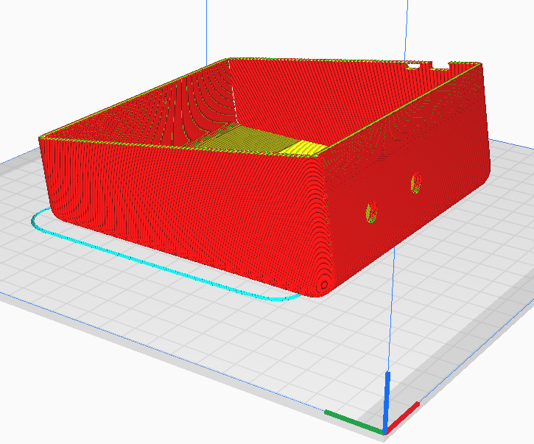
System Design – (Hardware)
The casing for the system was designed in SolidWorks and printed using Cura, to make a case suitable for mounting on a bicycle
Isometric View of casing in SolidWorks
Casing sliced for 3D printing in Cura

Slide 12




System Design – (Software)
Software Used :
Arduino IDE (C) – for programming the Uno
Visual Studio Code – for writing the Python and PHP script files for the server
Wordpress – for building the server
Proteus – for visualizing the system layout and simulation
Solidworks – Casing Design
Cura – for slicing and 3D printing the designed casing

Slide 13
JSON – JavaScript Object Notation
Type of file format used for the interchange of data.
Commonly stored in attribute-value pairs
PHP – PHP Hypertext Preprocessor
Used on the server-side usually in order to process data and interact with databases
Works with web applications

Slide 14
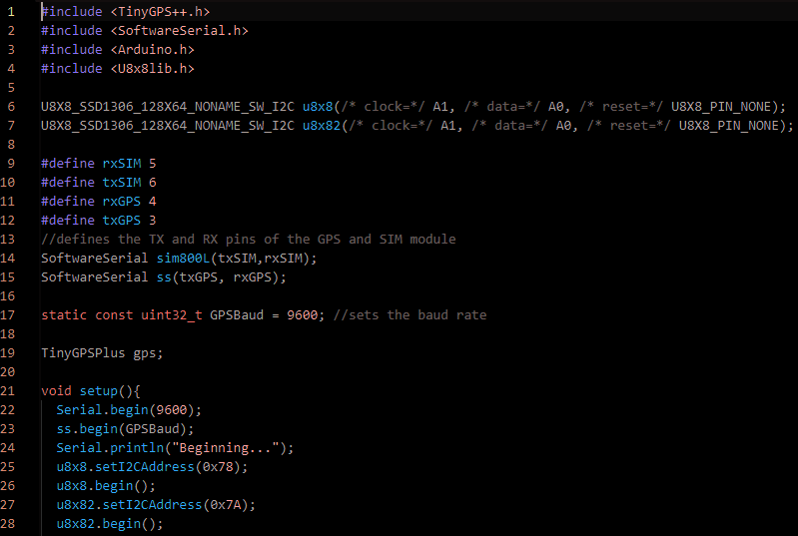
System Design – (Software)
The main Arduino code utilized the TinyGPS++ and U8X8 libraries to read the GPS data and drive the displays respectively.
U8X8 library was used to conserve program memory.

Slide 15
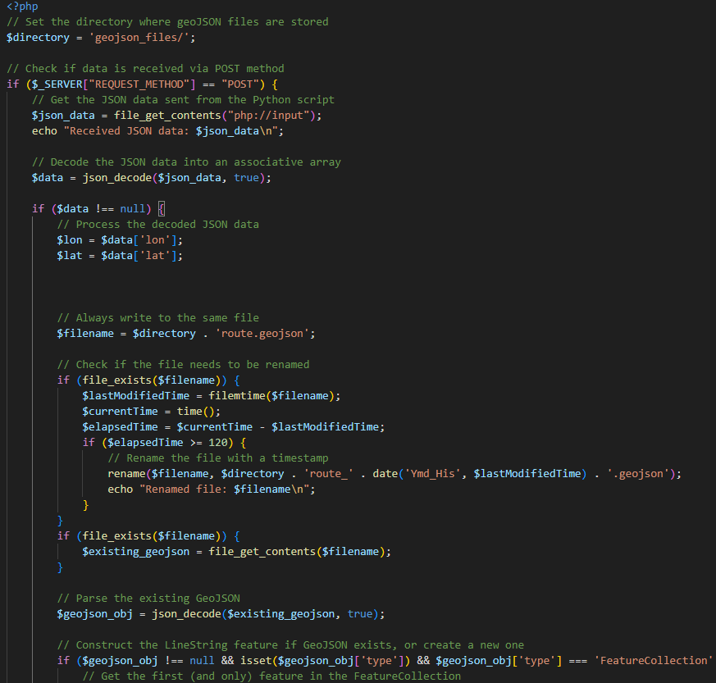
System Design – (Software)
The SIM800L sends HTTPS POST requests to a preconfigured server hosted on a Wordpress site.
A custom designed PHP script parses the received data and formats it into a GeoJSON file readable by a Map plugin.

Slide 16
Limitations
Physical
The physical switch for the battery pack is located in such a way that switching the device on and off is difficult.
Casing has issues due to 3D printing limitations
Battery Pack and Arduino take up physical space that could be minimized in an actual product (possibly LiPo/ATMega microcontroller)
Screen has no protection from outside
Software
Server hosting can be faulty at times
SIM800L HTTPS connections fail 50% of the time
NMEA speed variable can contain jitter

Slide 17
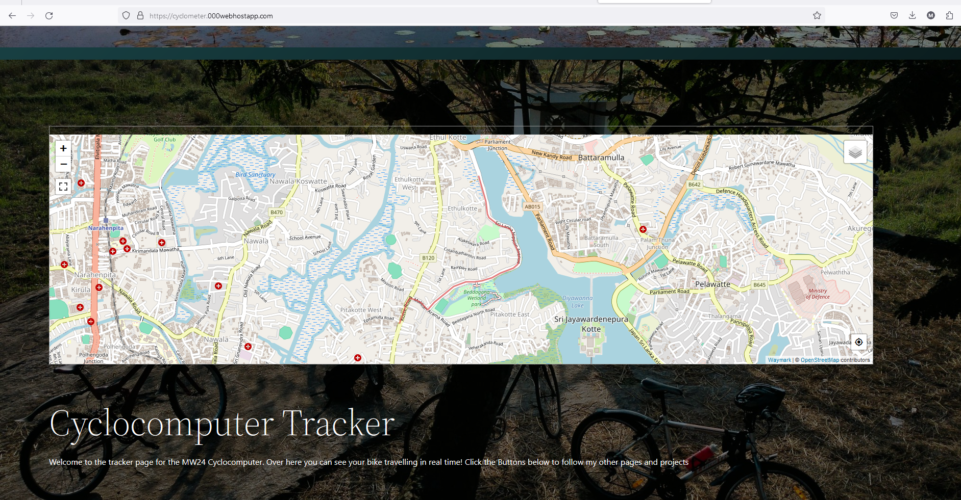

Product Outcome
The website of the tracker

Slide 18
Product Outcome
Positive Effects of the Product:
Provides motivation and encouragement for cyclists
Makes GPS based cycle tracking more accessible to those with budget constraints
Increased Safety Awareness
Negative Effects of the Product:
Could pose a potential distraction to cyclists
Data privacy issues, as cyclists location Data is being collected
In total, the product is about 70% complete, considering the various design factors

Slide 19
Product Outcome
Proposed Applications
If mass manufactured, this device could be a simple, cost-effective method of tracking cycling data with GPS
Useful for hobby cyclists or fitness enthusiasts

Slide 20
Conclusion
In conclusion, this project has granted invaluable insight into the effort involved in conceptualizing, designing, deploying, and testing an electronic device. Topics such as
GPS systems
Packet Data/ GPRS connections
OLED and other forms of displays
PHP and Javascript server based scripts and programming
3D modelling and printing
were all explored over the course of this project

Slide 21
Future Improvements
Adding a proper physical switch to the casing
Reducing physical size by switching from Arduino to a small microcontroller + PCB
Integration with other fitness apps/ trackers such as Strava, Google Fit, etc.

Slide 22
REFERENCES
[1] S. Sport, “BC 8.0 WL,” SIGMA SPORT, https://sigmasport.com/product/bc-8-0-wl/ (accessed Apr. 1, 2024)
[2] G. Ltd. or its subsidiaries, “Garmin EDGE® 530: Cycling computer with Performance Insights,” Garmin, https://www.garmin.com/en-US/p/621224 (accessed Apr. 1, 2024).
[3] Arduino, “Uno R3,” Getting Started with Arduino Uno, https://www.arduino.cc/en/Guide/ArduinoUno (accessed Apr. 1, 2024).
[4] Masterfalcon, “How to connect neo 6M GPS module?,” Arduino Forum, https://forum.arduino.cc/t/how-to-connect-neo-6m-gps-module/939321 (accessed Apr. 1, 2024).
[5] tronic.lk, “MD0147 - SIM800L Quad-band GSM GPRS module with Antenna V2.2 5V for Arduino,” TRONIC.LK, https://tronic.lk/product/sim800l-quad-band-gsm-gprs-module-with-antenna-v2-2-5v- (accessed Apr. 1, 2024).
[6]Amazon, “Amazon.com: Diymore 1865O battery holder double li-ion V8 battery ...,” diymore 1865O Battery Holder V8, https://www.amazon.com/Diymore-Lithium-Battery-Charging-Arduino/dp/B07SZKNST4 (accessed Apr. 1, 2024).

Slide 23
REFERENCES
[7] AZDelivery, “0.96 inch OLED SSD1306 display I2C 128 x 64 pixels compatible with Arduino and Raspberry Pi,” AZ, https://www.az-delivery.de/en/products/0-96zolldisplay (accessed Apr. 1, 2024).
[8] tronic.lk, “MD0306 - XL6009 3-32V to 5-35V 4A DC to DC adjustable step-up Boost Power Supply Module,” TRONIC.LK, https://tronic.lk/product/xl6009-3-32v-to-5-35v-4a-dc-to-dc-adjustable-step-up-bo (accessed Apr. 1, 2024).
[9] tronic.lk, “MD0067 - 4-channel 3.3V 5V Bi-Directional Logic Level Shifter Module,” TRONIC.LK, https://tronic.lk/product/4-channel-3-3v-5v-bi-directional-logic-level-shifter-mo (accessed Apr. 1, 2024).

